Slide 1
Coping with Stress

Slide 2
We all feel some level of stress
Stress is a natural reaction
Not all stress is bad
Toxic stress is a reaction to a situation that is outside of our control
Learning how to manage and cope with the stress that is under our control is important for maintaining our mental health
Talking with someone about your stress can help you identify the things that you can control and cannot
Stress and anxiety can be different

Slide 3
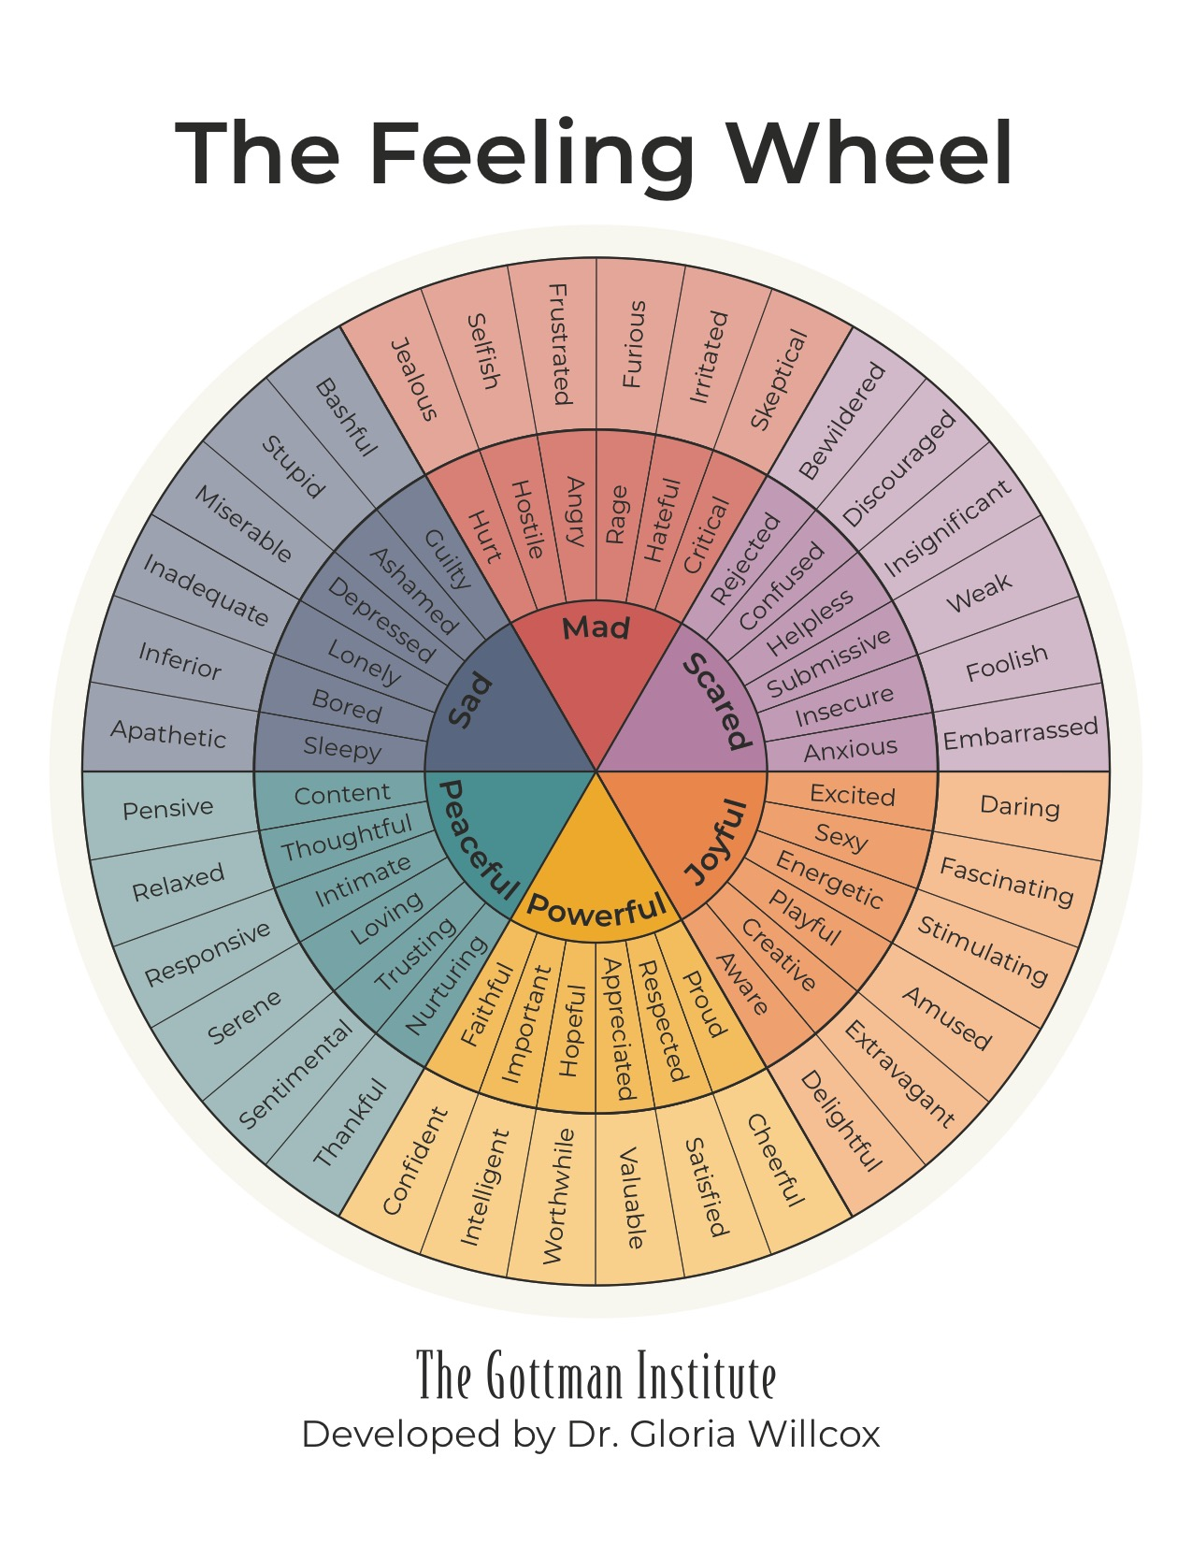
Notes:
Naming the feeling isn’t always easy
Naming can be the first step in managing the stress; when you’re in the emotional you react rather than respond; naming can be grounding; counselors can help you unpack
Example; feeling overwhelmed
Muscle you have to build; can’t do 20 push-ups the first time

Slide 4
5 Quick Coping Techniques
Exercise
Gratitude
Prioritize Sleep
Get Social
Talk to a trusted adult
Notes:
Get your body moving for 30 minutes – take a walk, do an exercise video or some yoga poses – open your window
Take some time to think about the things that are positive right now -

Slide 5
How to make an appointment
Shorecrest Website – https://www.shorelineschools.org/
Canvas Course - https://shorelineschools.instructure.com/
Call Counseling Office – 206 393 4296
Email your individual counselor
Email Ms. Coquille for an appointment
coquille.johnson@shorelineschools.org

Slide 6
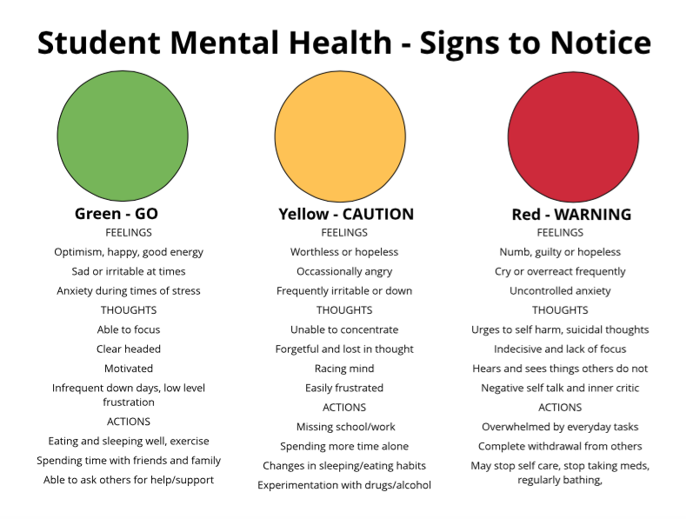

Slide 7
Concern for suicidal feelings and thoughts
If you notice yourself or a friend heading into the red zone and experiencing urges to self-harm or suicidal thoughts or, don’t hesitate to reach out and connect:
Let a trusted adult know right away
Connect with Teenlink - https://www.teenlink.org/
Call the Crisis Line – 206 461-3222 or Text ‘Heal” to 741741
Call 911 if you feel like you or someone you know is in immediate danger

Slide 8
